Slide 1
Be functional
an introduction to metaprogramming and lambda
David Wang

Slide 2
Paradigms of programming
Imperative
Procedural
Object Oriented
Declarative
Functional
Logical
DSL (Regex, SQL, Configuration, etc)

Slide 3
Alan Turing
Alan Mathison Turing was a British pioneering computer scientist, mathematician, logician, cryptanalyst, philosopher, mathematical biologist.
Turing is widely considered to be the father of theoretical computer science and artificial intelligence.

Slide 4
Turing machine

Slide 5
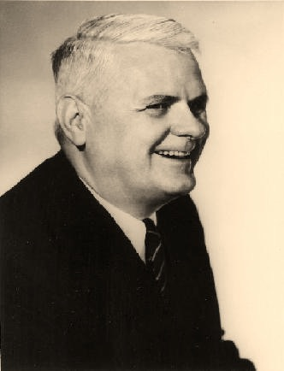
Alonzo Church(λ-calculus)
Church was an American mathematician, who is best known for the lambda calculus, Church–Turing thesis, proving the undecidability of the Entscheidungsproblem, Frege–Church ontology, and the Church–Rosser theorem.

Slide 6
mechanical vs mathematical

Slide 7
why does it matter?
High abstraction
Less error-prone
Concurrent application
The other way around to see programming

Slide 8
Lisp in 5 minutes

Slide 9
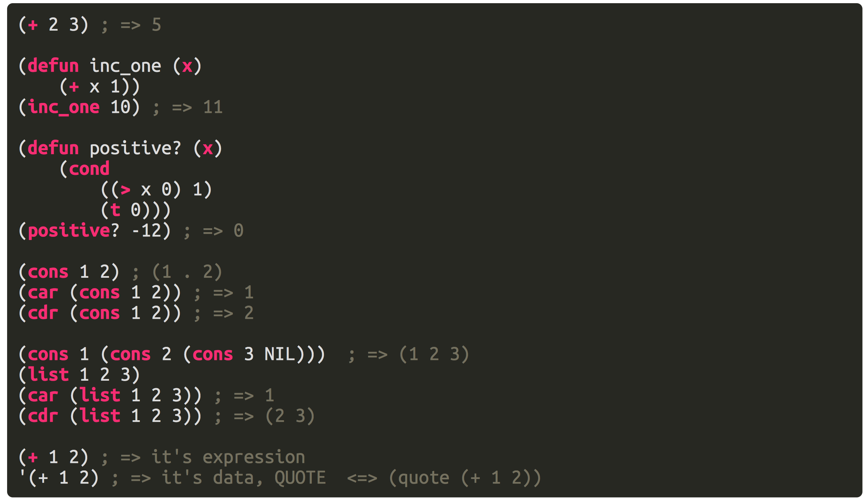
Core language

Slide 10
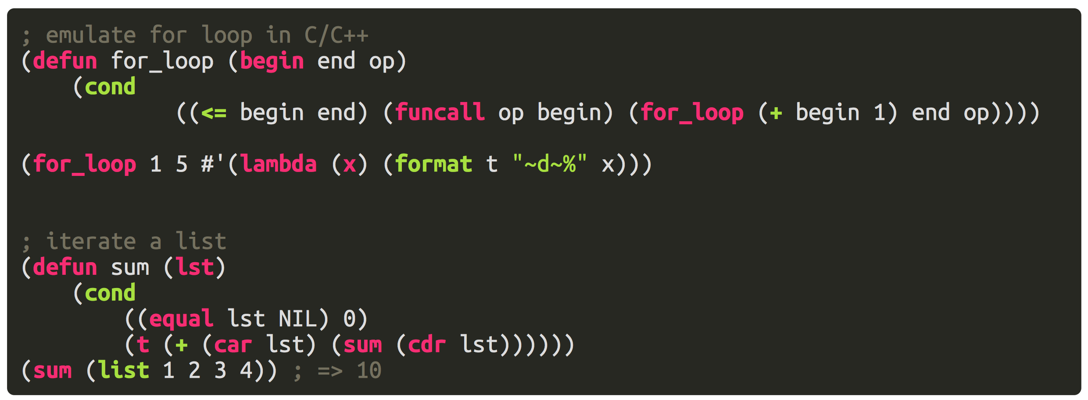
Core language

Slide 11
No variables?

Slide 12
No side effects! timing is never an problem now

Slide 13
So function, is really an function in mathematical sense

Slide 14
Referential Transparency f(12) = f(12)

Slide 15
Limitation
How can we model real world without state?
How can they be a mathematical function?
print(msg) -> what's the return value?
read() -> a function without a arguments is constant?
Record the history
(cons new_value previous_values), to write a variable
(car value), read a variable
RealWorld Solution
print :: (RealWorld, String) -> (RealWord)
read :: RealWord -> (RealWorld, String)
In Haskell: Monad

Slide 16
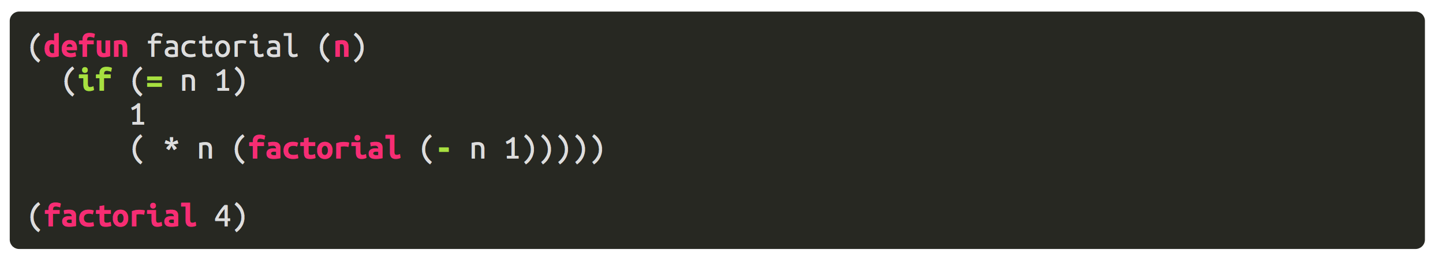
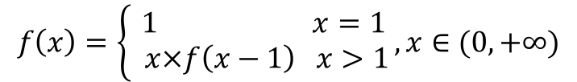
The functional way
$$f\left(x\right)=\left\{\begin{aligned} 1 x=1 \\ x×f\left(x−1\right) x>1\end{aligned}\right., x∈(0, +∞)$$

Slide 17
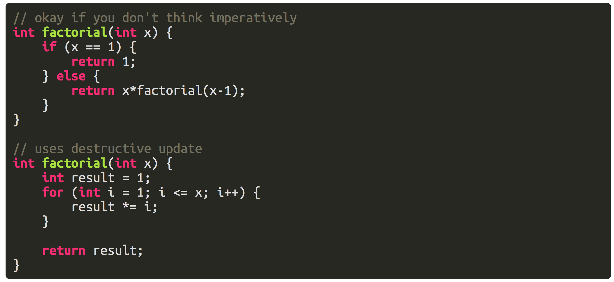
The non-functional way

Slide 18
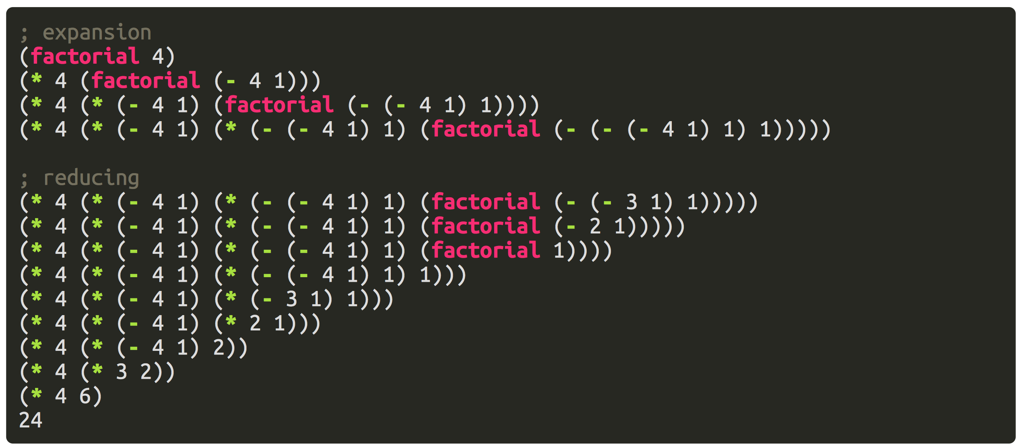
Substitution Model Explained
LISP == LISt Processing

Slide 19
why does it matter?
High abstraction
Less error-prone
Concurrent application
The other way around to see programming

Slide 20
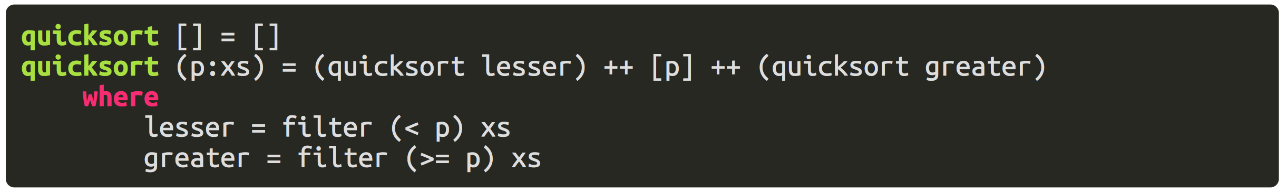
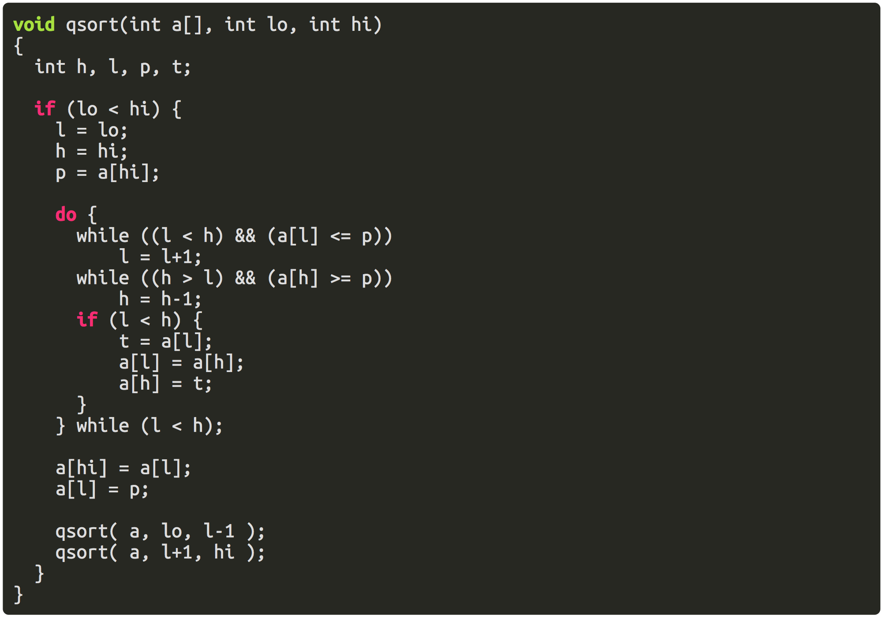
Quick Sort

Slide 21
In Financial IT field?

Slide 22
Closure

Slide 23
Alias
Closure
Lambda
Anonymous function
function with lexically scoped name binding

Slide 24
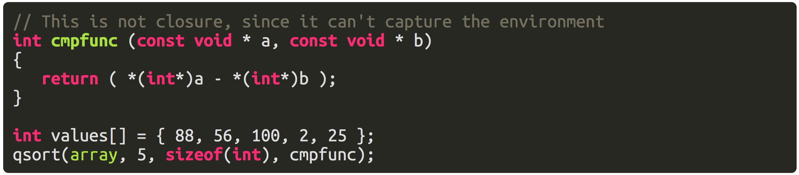
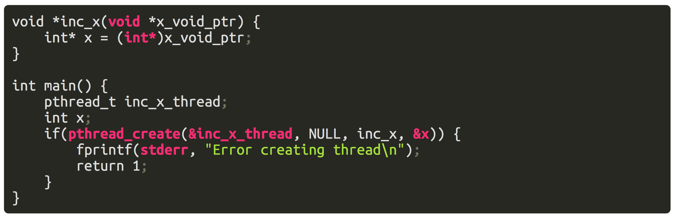
Old days with C
We can only capture the environment manually.

Slide 25
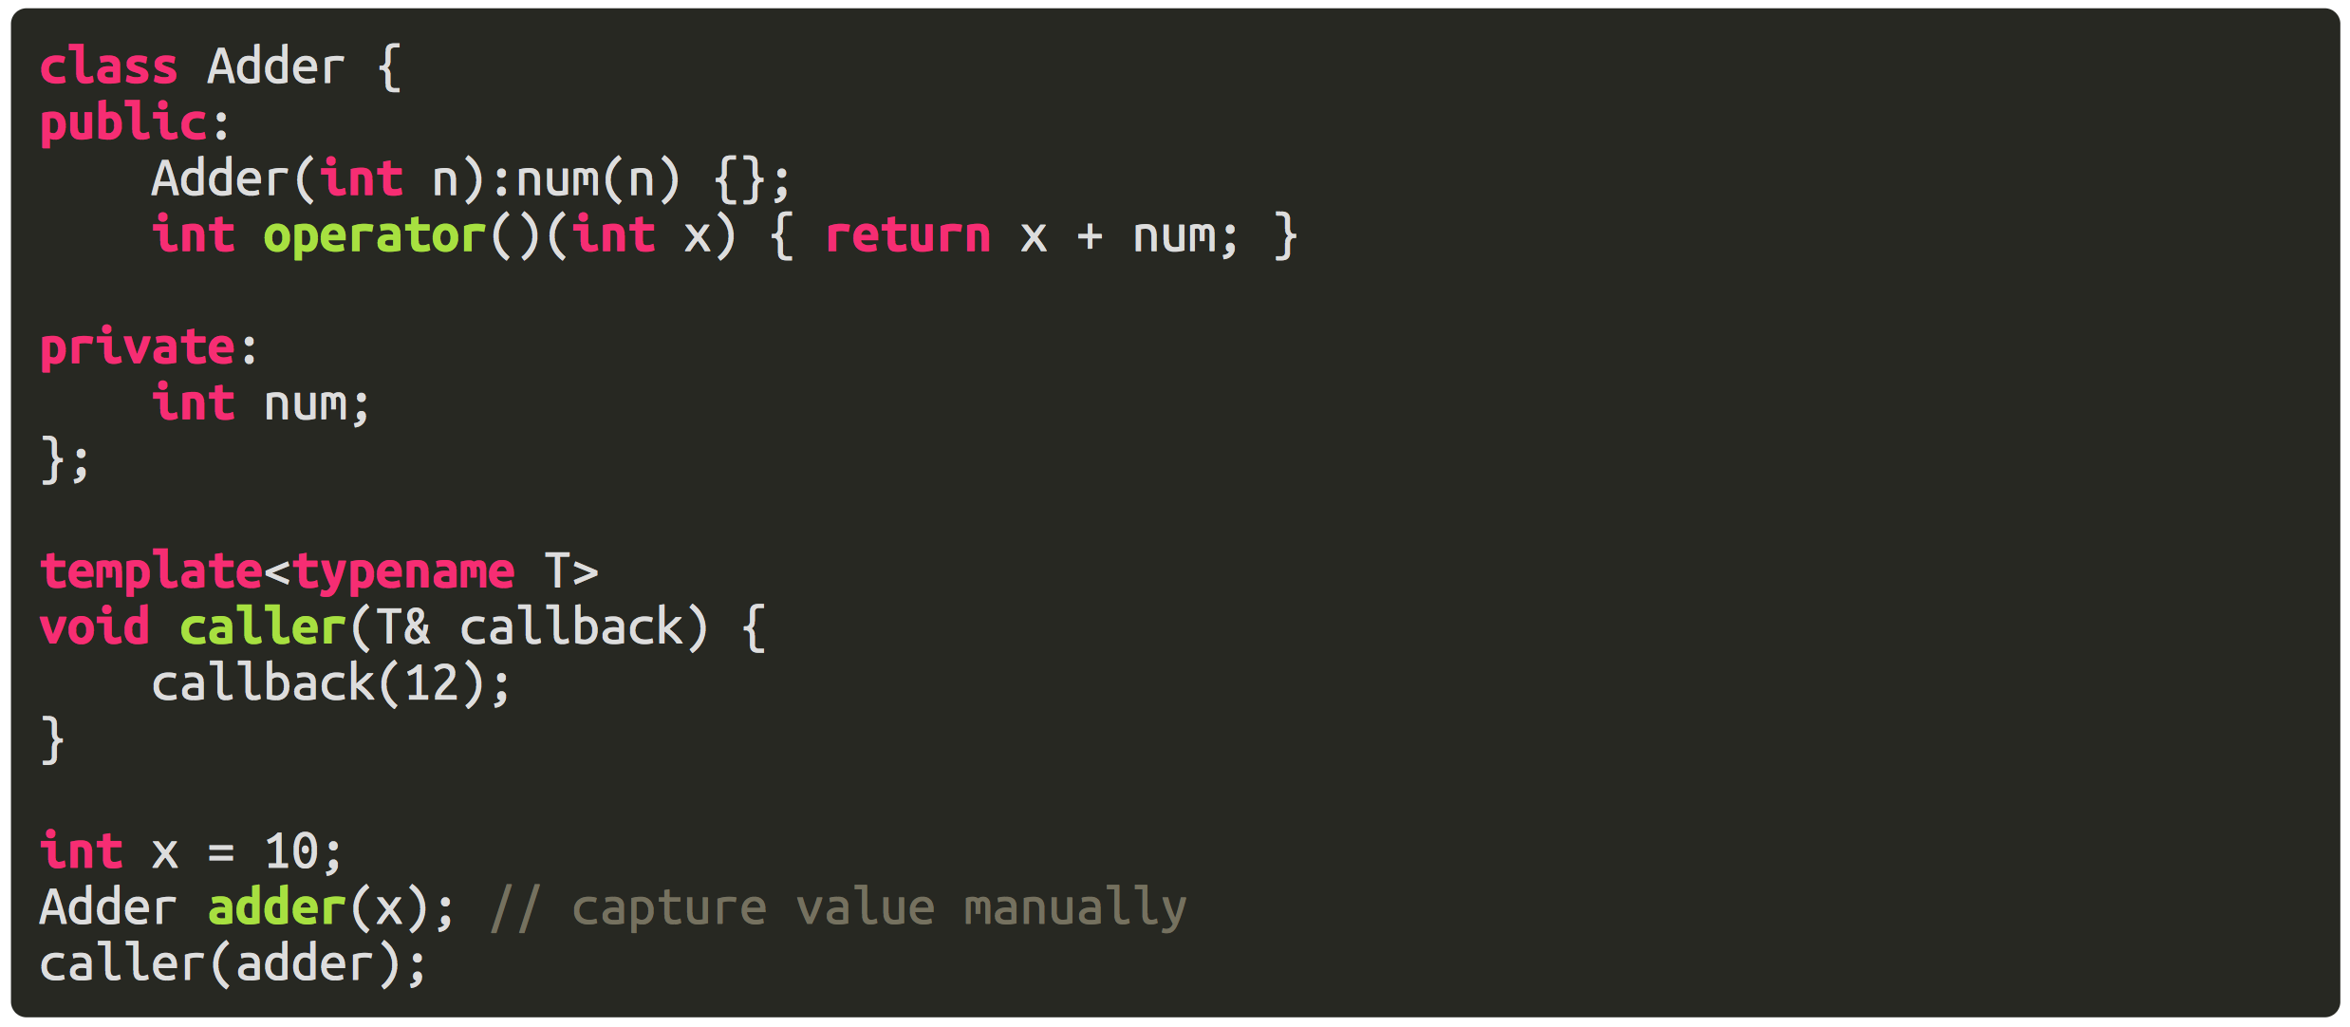
Better time with functor in C++

Slide 26
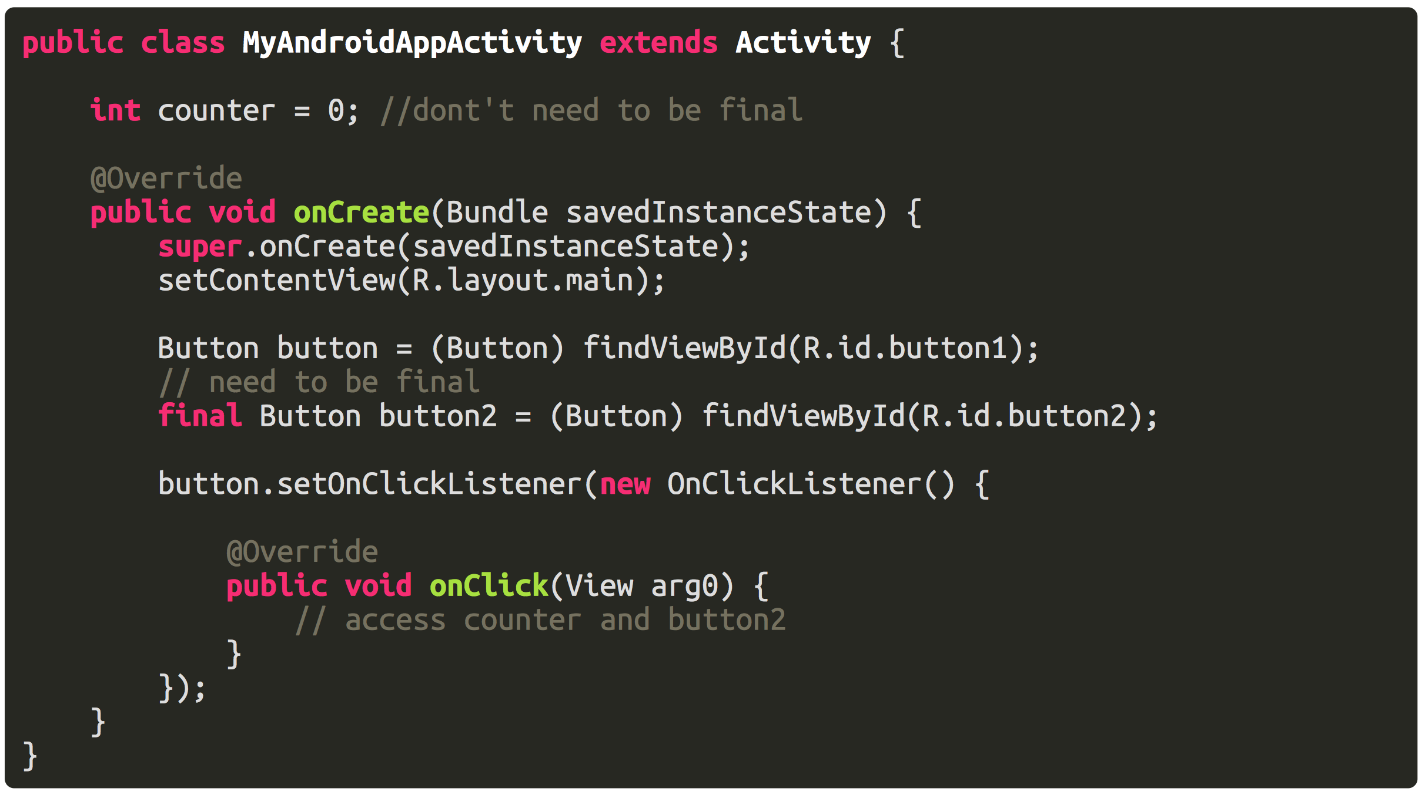
Java’s Anonymous class
It’s impressive if you’ve developed Android app

Slide 27
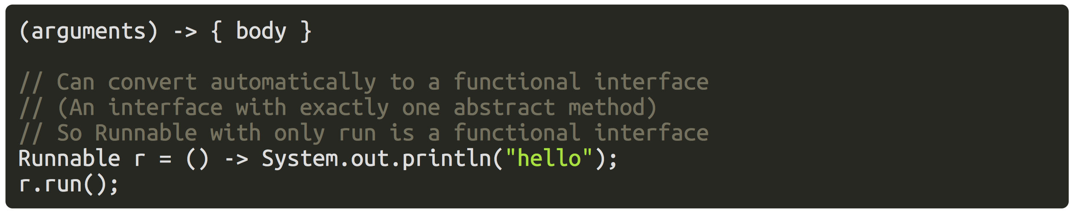
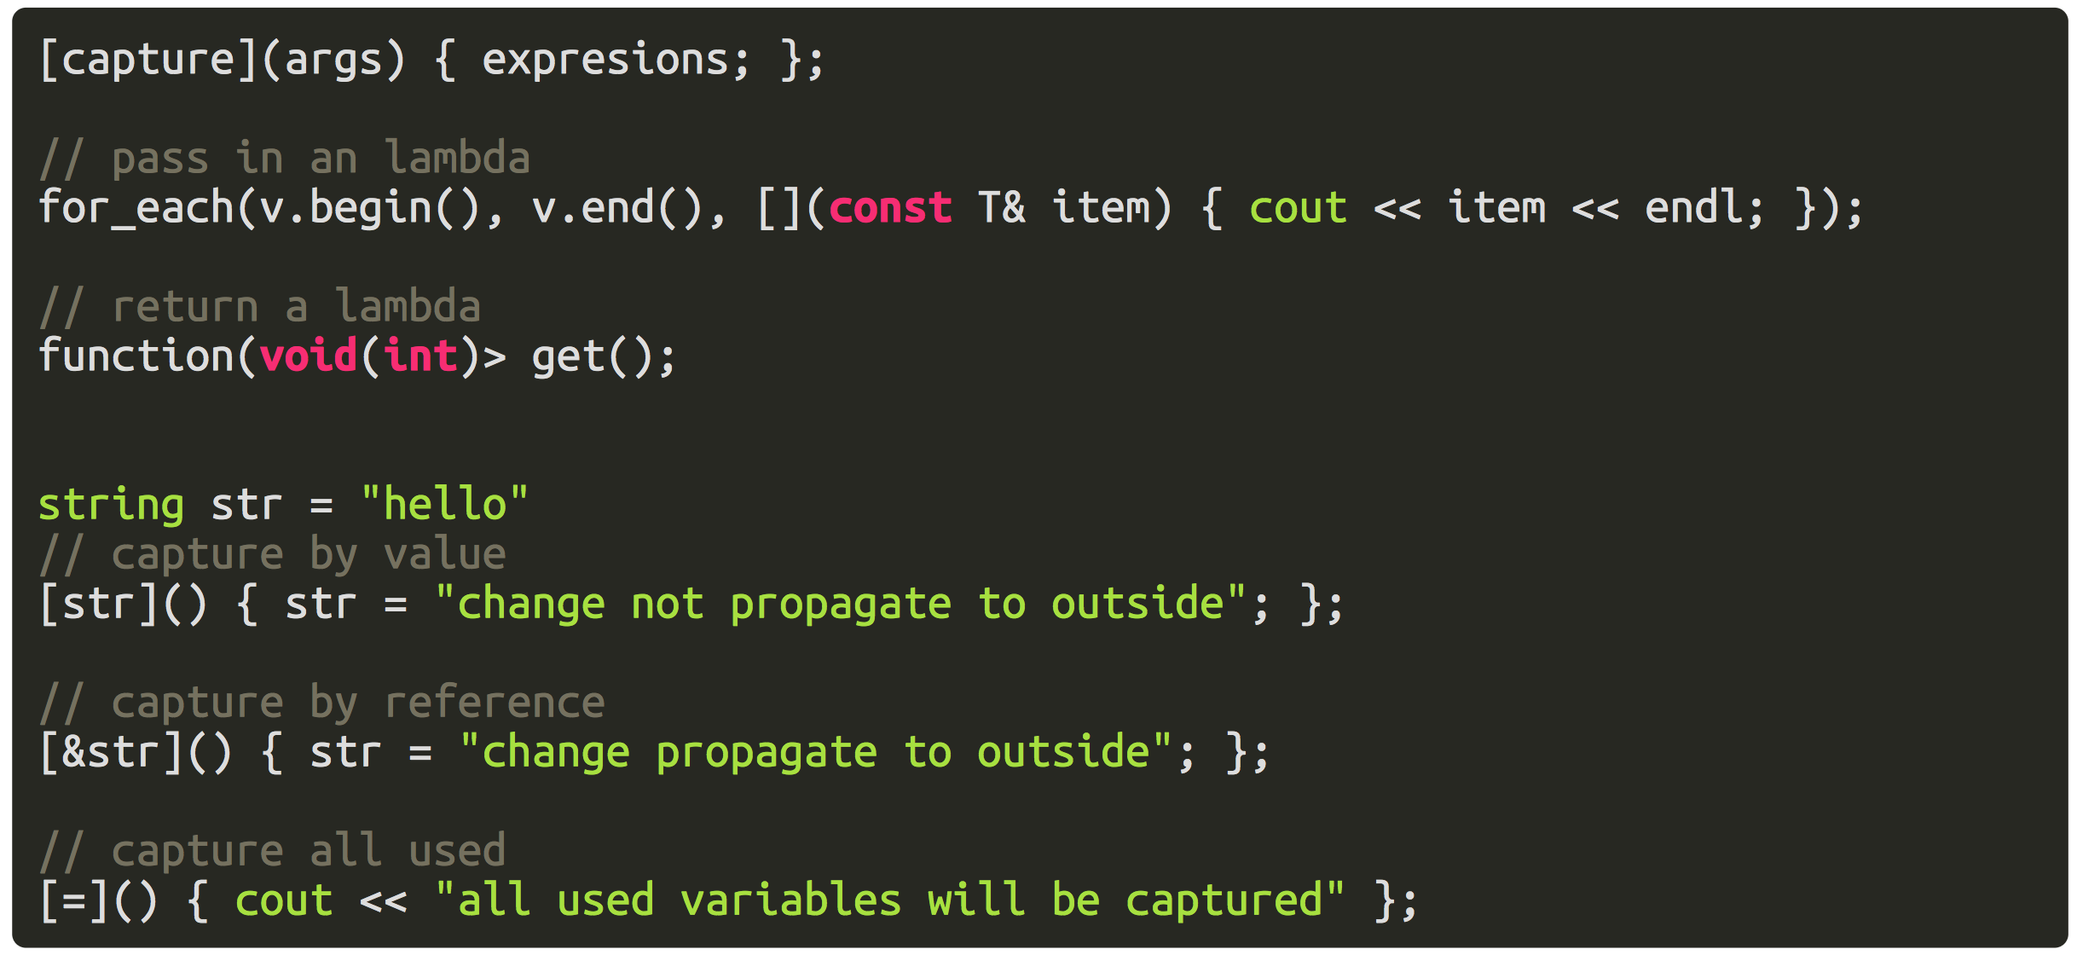
Lambda in Modern Languages

Slide 28
Closure = Function + Environment
Also requires that function is first class, it can be passed back and forth just like primitive data types, and can be parameters to other function(higher order function).

Slide 29
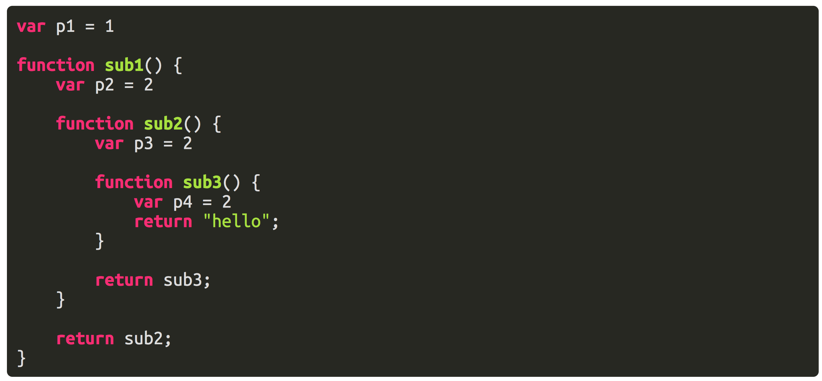
Lexical Scoped Name Binding

Slide 30
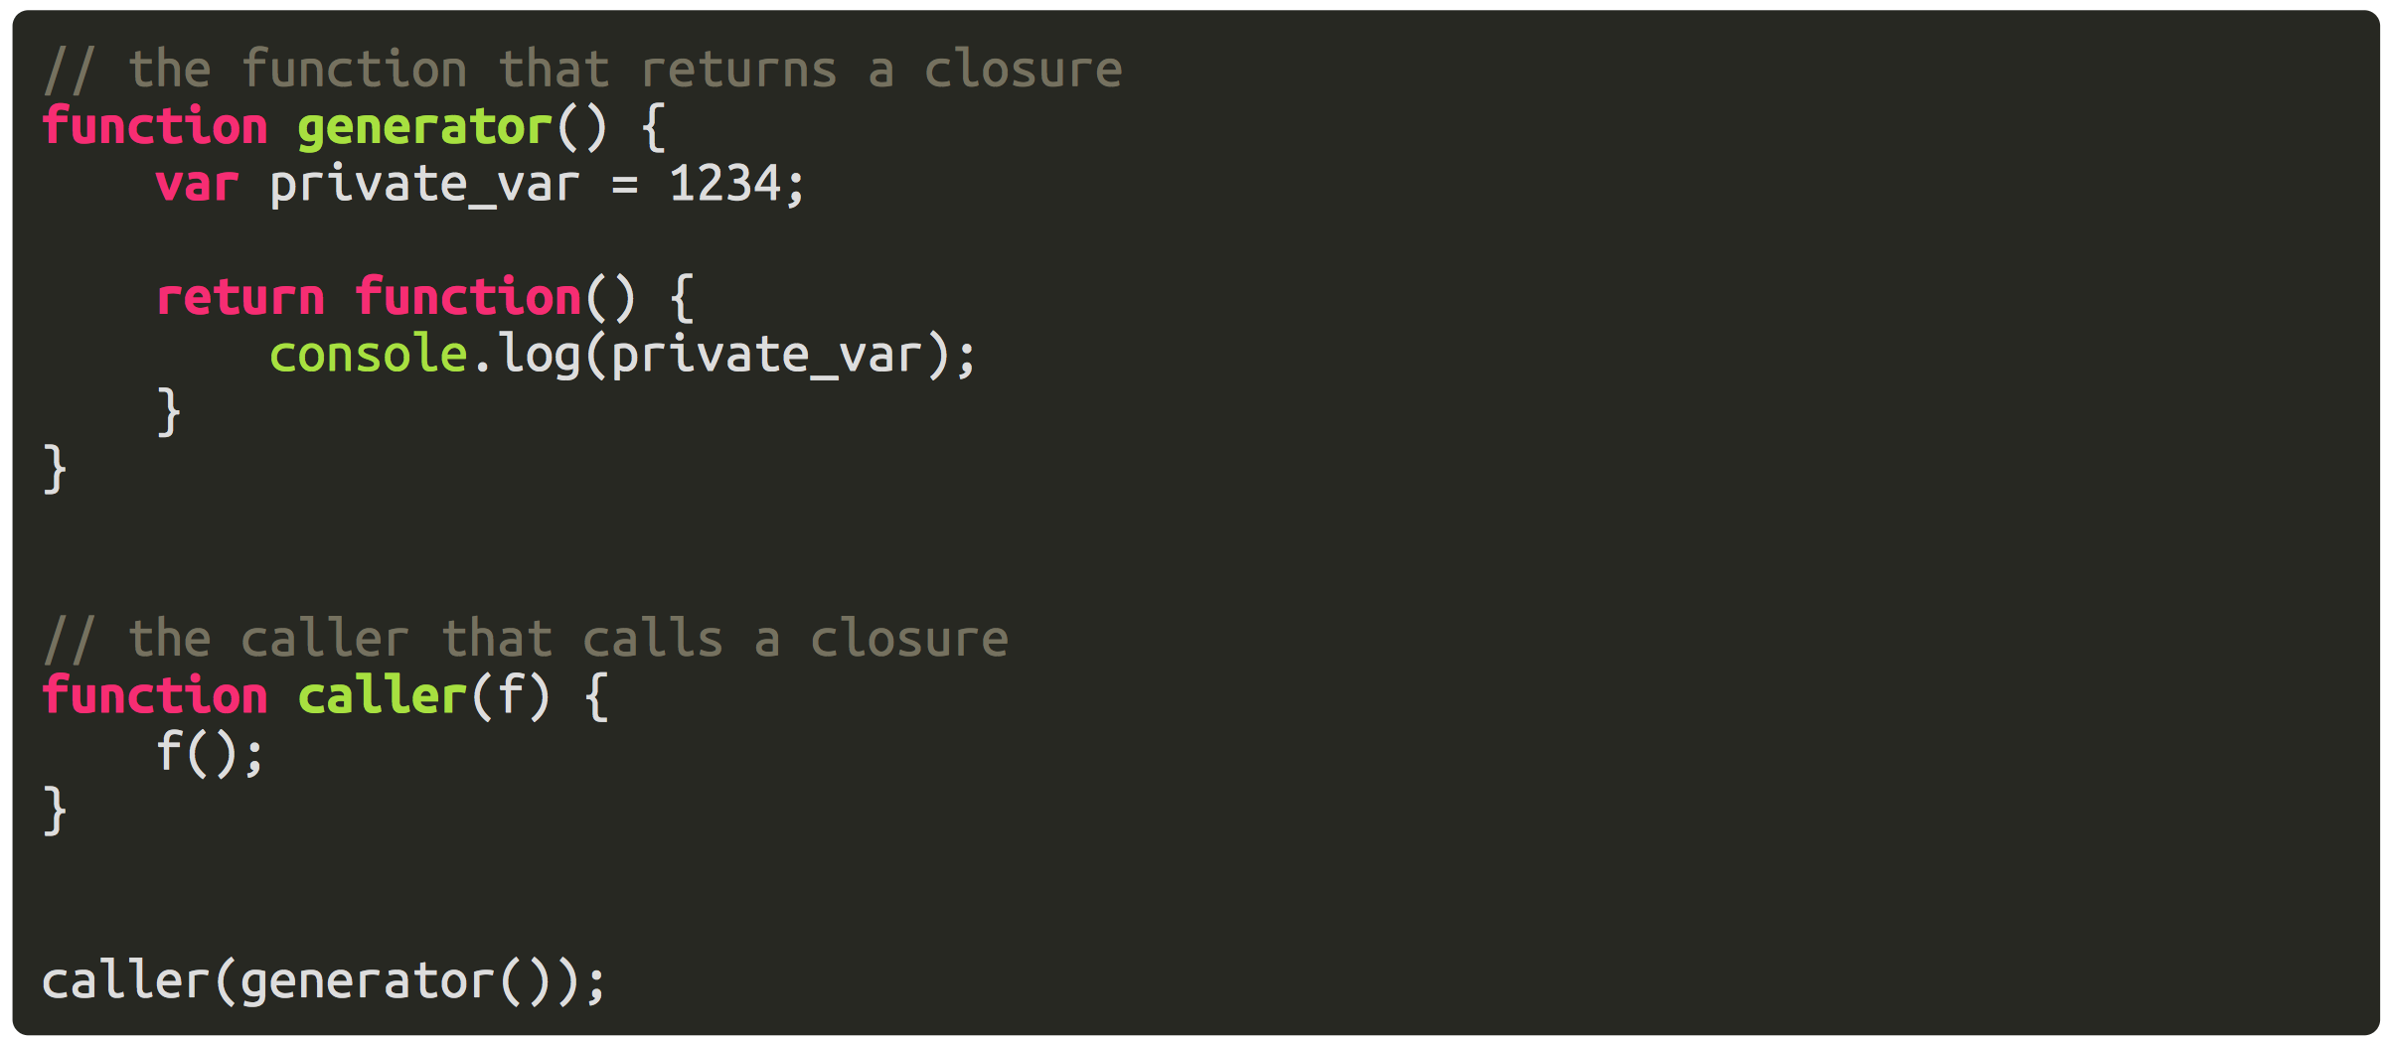
Not Confused With Calling Stack
By the time we execute the anonymous function, the enclosing scope is generator's, but the last stack frame is caller's.

Slide 31
Funarg Problem
Difficulty in implementing first-class functions in programming language implementations so as to use stack-based memory allocation of the functions.
Upwards Funarg Problem
Downwards Funarg Problem

Slide 32
metaprogramming

Slide 33
Program = Code + Data ?!

Slide 34
Have you heard of Shell code?

Slide 35
Once we regard code as a kind of data, we should have ability to inspect the properties of code, and also manipulate it.
Java Reflection, C++ RTTI, C++ Template, Ruby, LISP

Slide 36
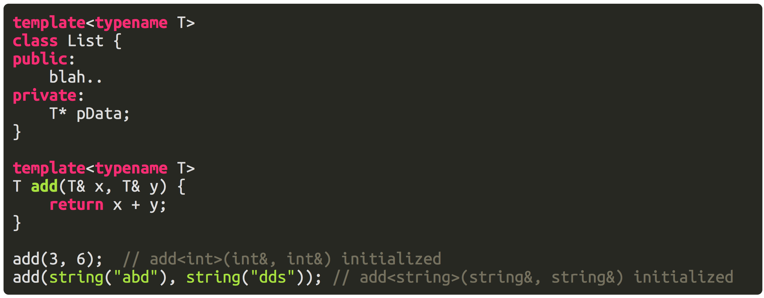
Template
Used to implement generics at beginning
It’s all about compile time code generation

Slide 37
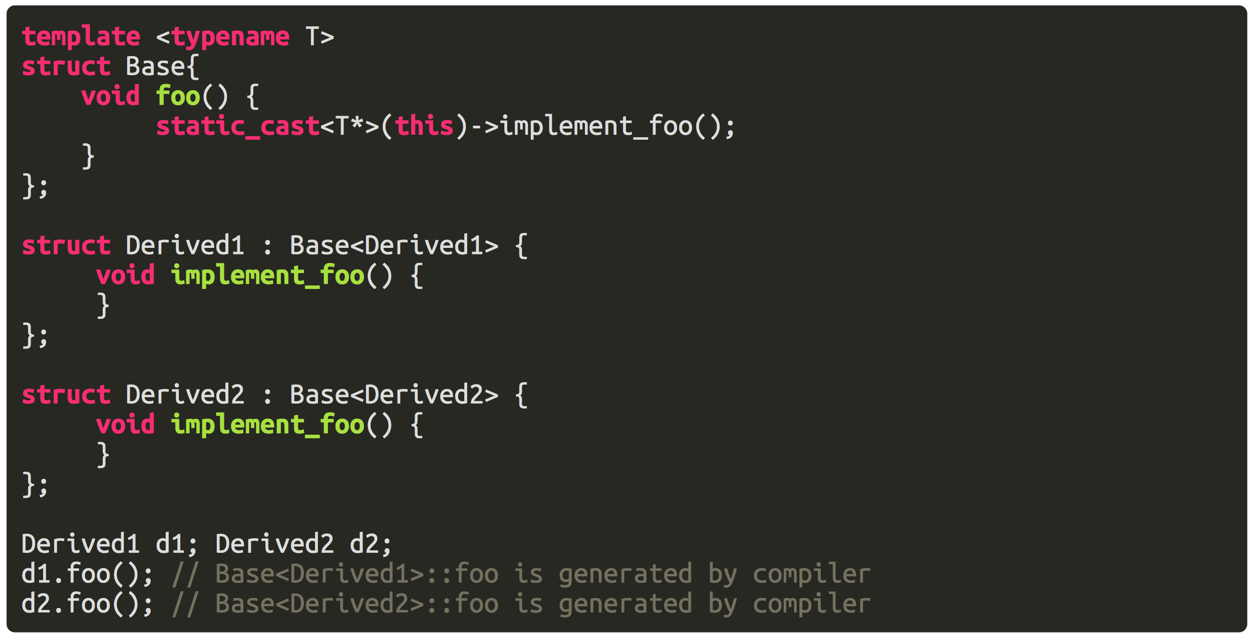
Static Polymorphism
We all know Polymorphism can be achieved by virtual keywords in C++. And at runtime, it involves looking up the vtable. But Polymorphism can also be achieved at compile time.

Slide 38
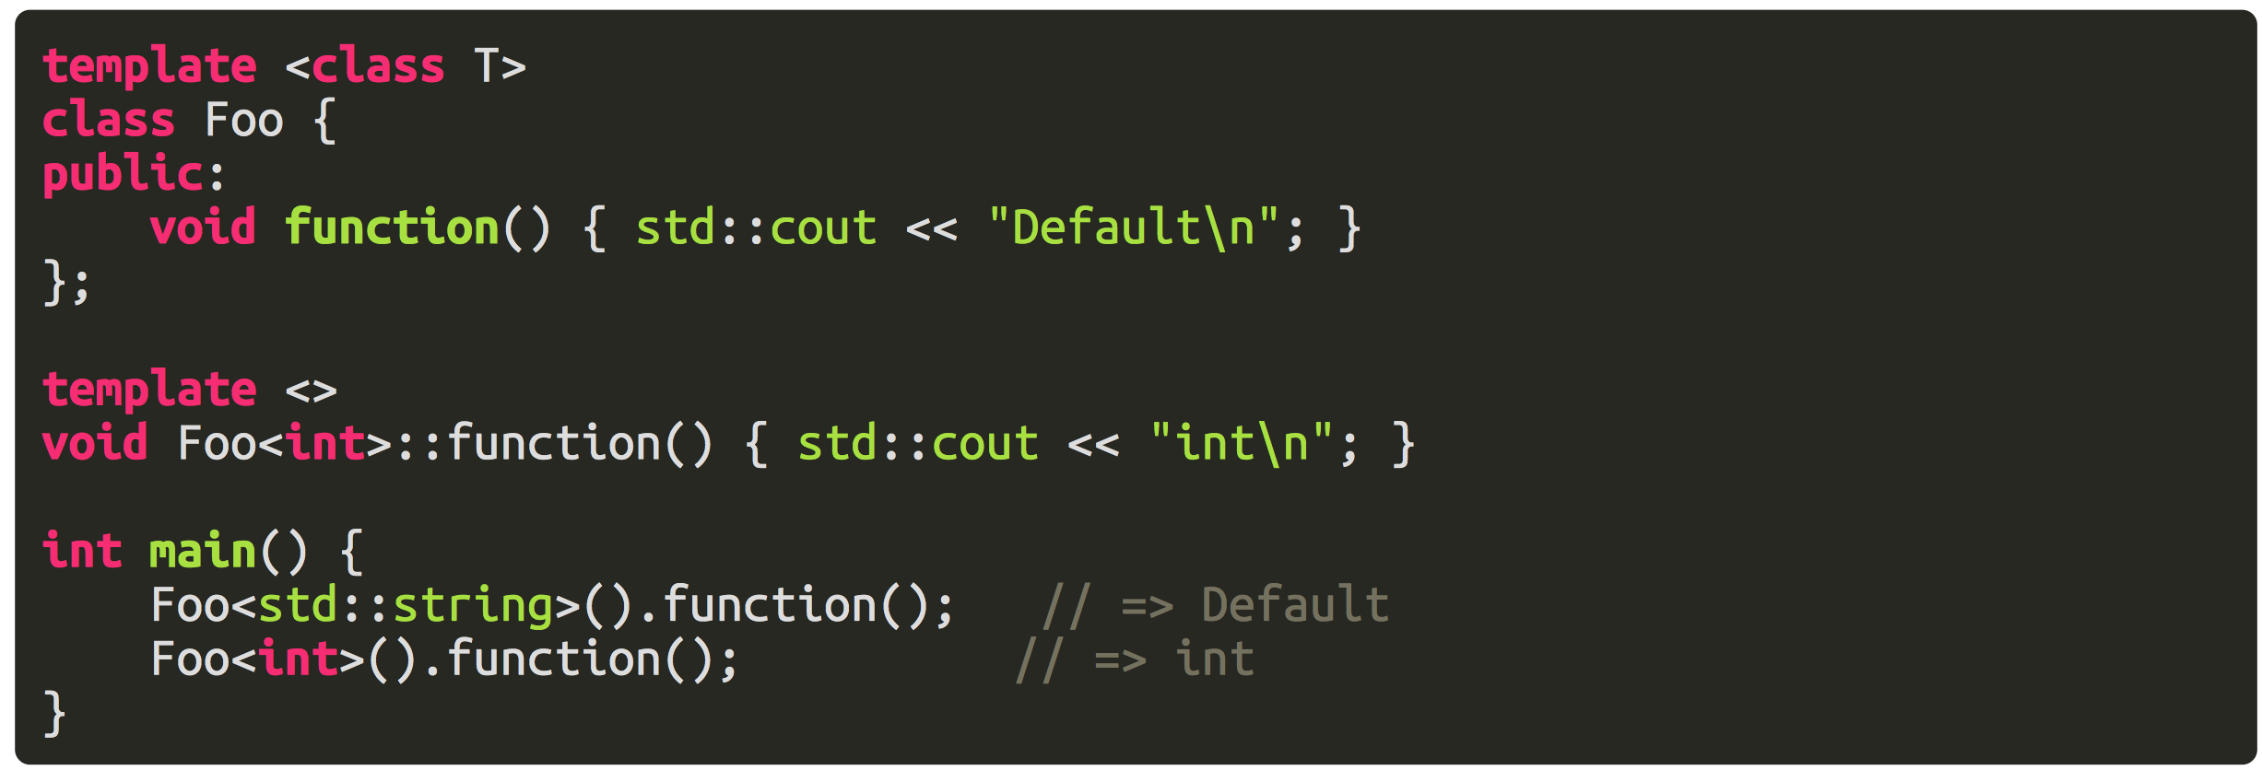
Pattern Matching

Slide 39
The truth is c++ template is Turing complete

Slide 40
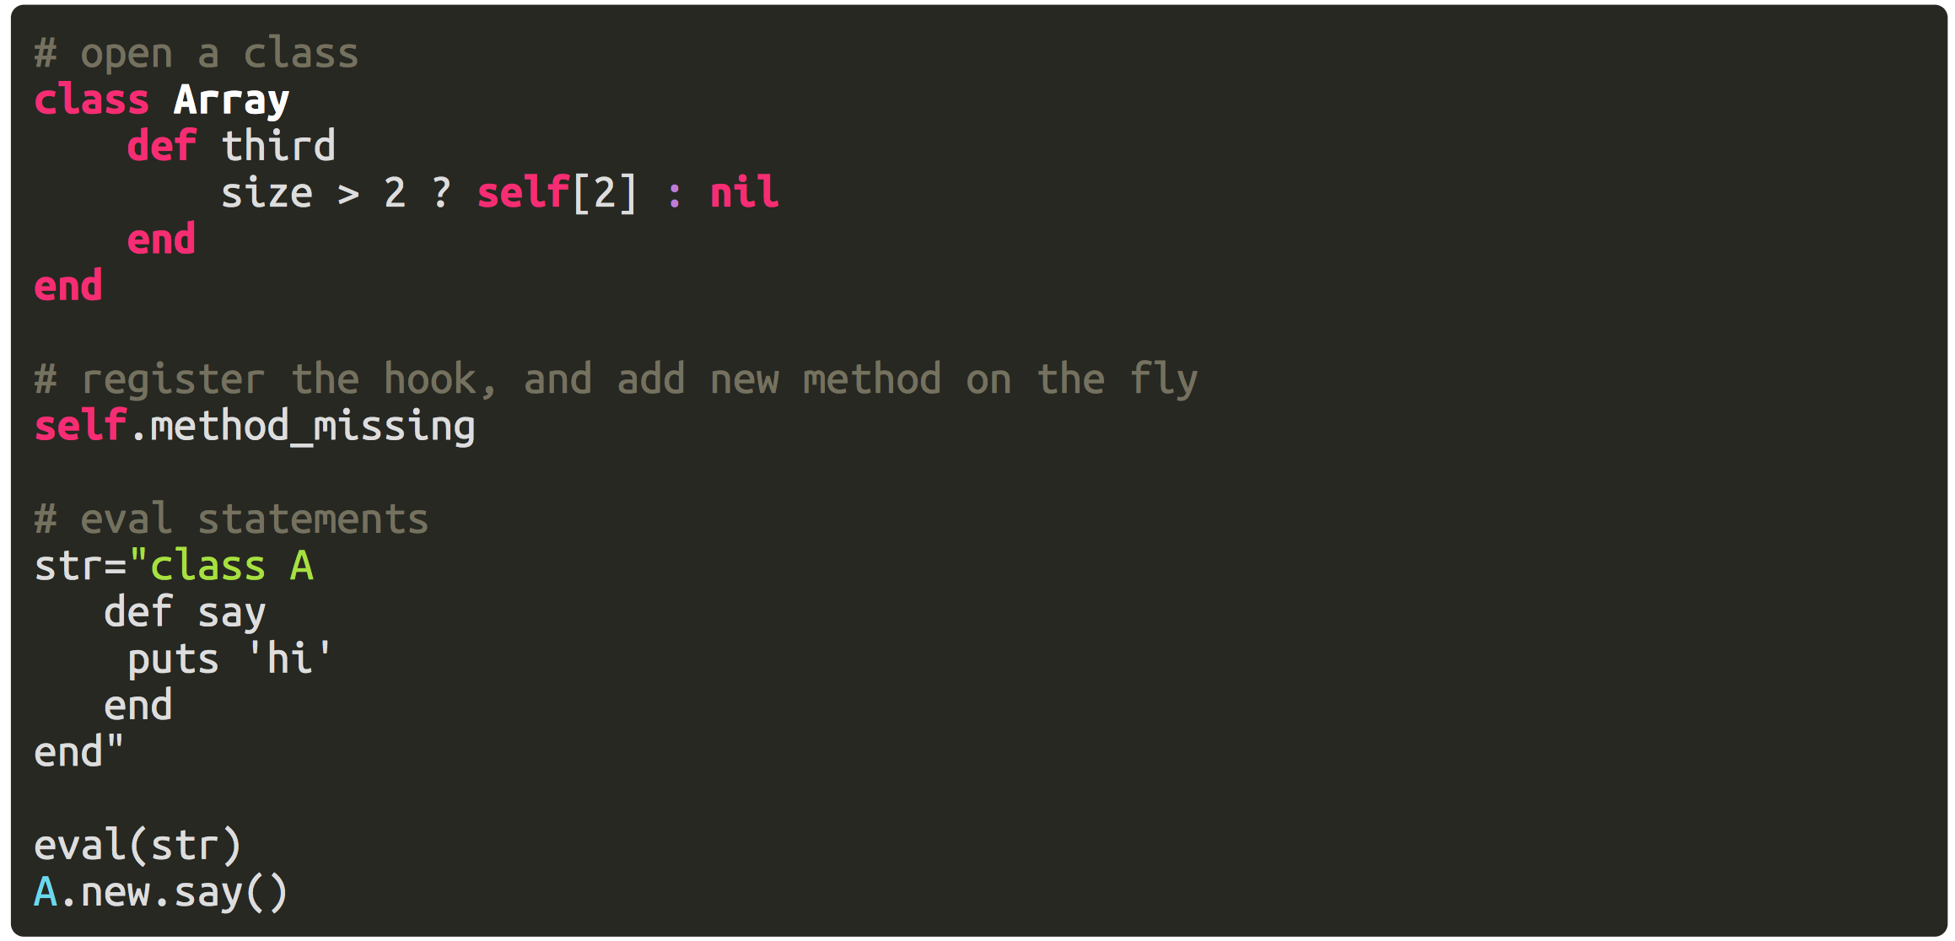
Ruby
Let’s find a representative from dynamic languages
JS Developer 笑而不语 ☺

Slide 41
LISP Macro
It‘s the most wonderful invention of LISP
Generate code on the fly
Extend the language (DSL, hackable)

Slide 42
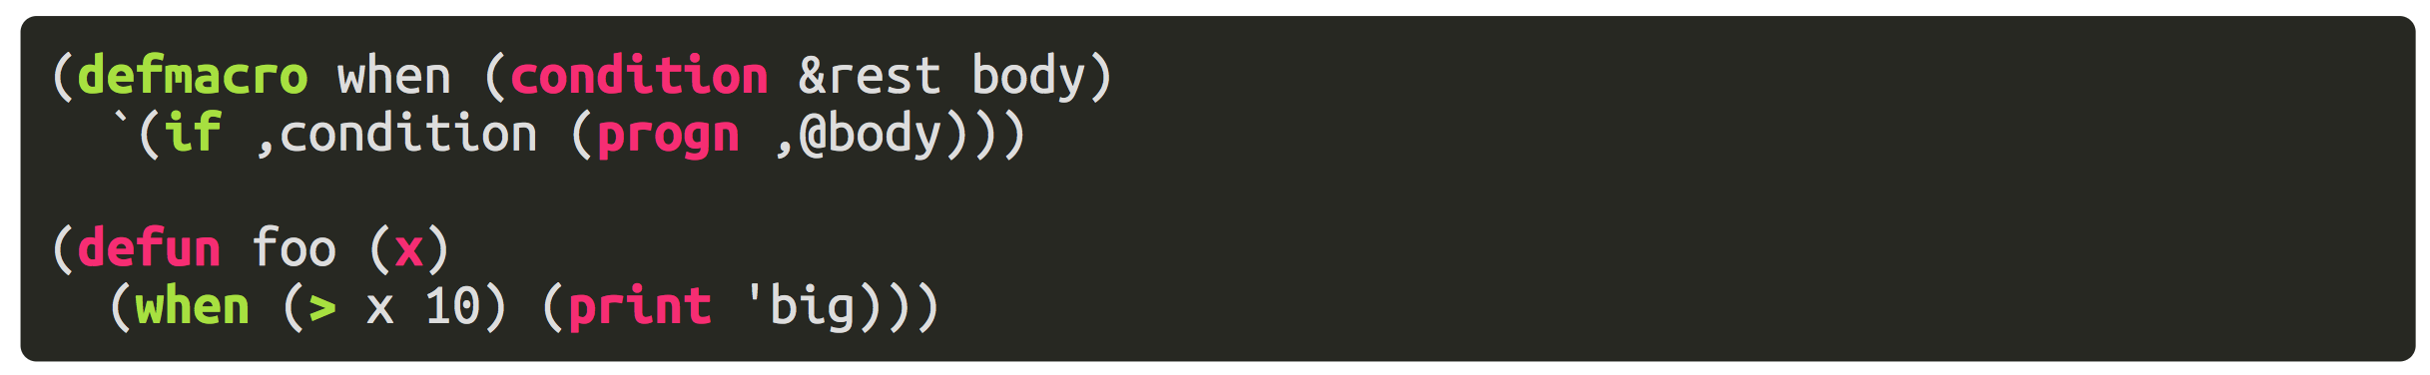
Code that generate code
It looks like plain C macros, but it’s definitely not. It is structured, contains complex code logic, and can be understood by compiler.

Slide 43
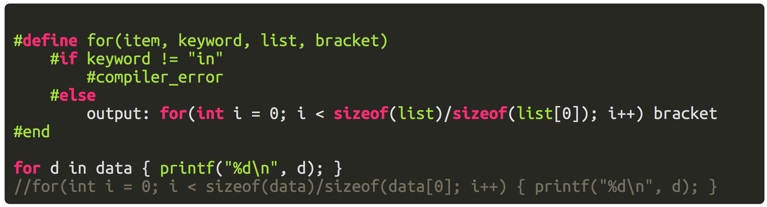
Analogy
It’s like a programmable C macro
Imaging we can program the C Macro, making it Turing complete

Slide 44
Extension of the language
Language Core
Standard Libraries
Third-Party Libraries
Syntax & Semantics is a black box in traditional languages, we can never change the language facilities of C (e.g. add foreach in C)

Slide 45
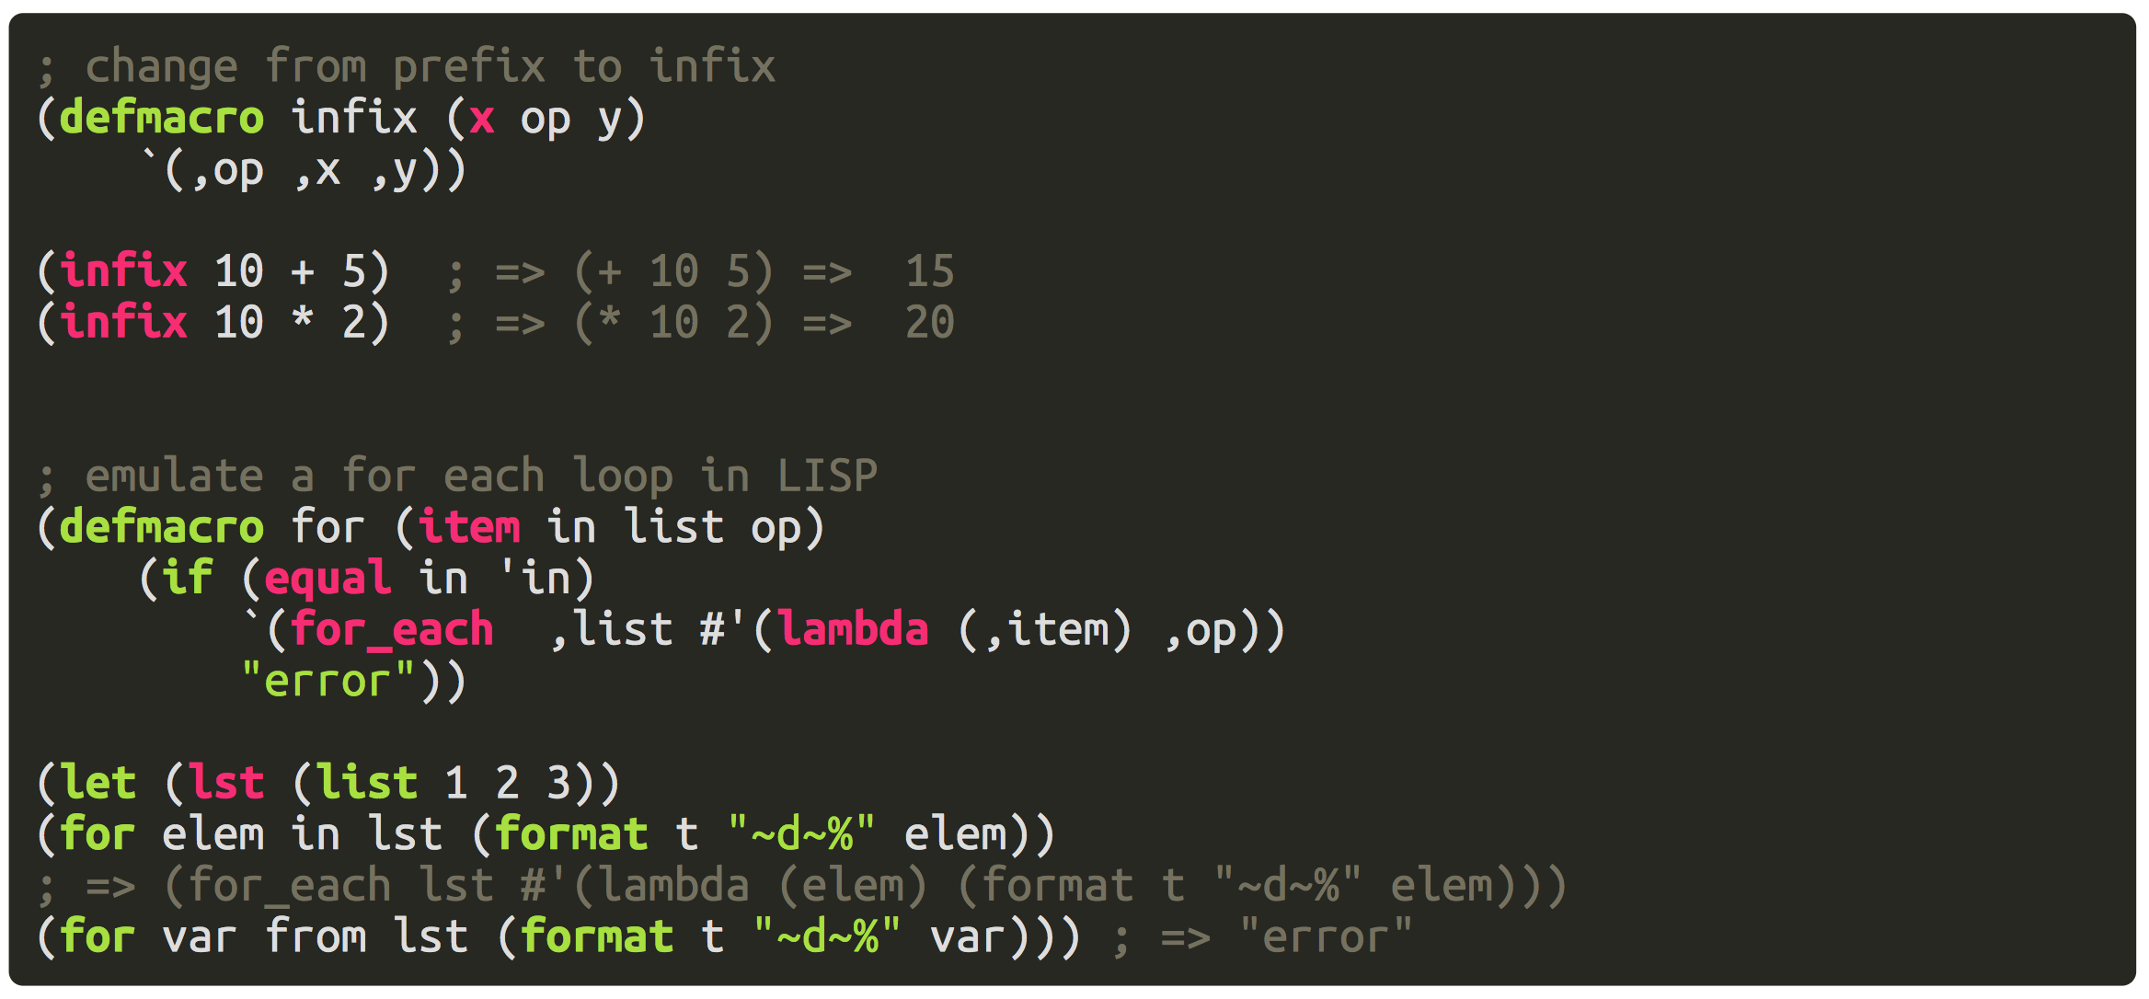
Syntax is hackable in LISP

Slide 46
Many Features not Covered
Lazy Evaluation
Currying
CPS (Continuation Passing Style)
Pattern Matching

Slide 47
fin.

